Slide 1
Data Visualization and Bias
Vanessa LoBue
Jamil Bhanji
with a little help from Andy Field

Slide 2
Aims
What is a statistical model?
Bias, and assumptions of parametric tests based on the normal distribution
Know how to handle problems in the data
Data visualization techniques

Slide 3
A Simple Statistical Model
In Statistics we fit models to our data (i.e. we use a statistical model to represent what is happening in the real world)
The mean is a hypothetical value (i.e. it doesn’t have to be a value that actually exists in the data set)
As such, the mean is simple statistical model
Notes:
One of the simplest models we use in statistics is the mean. Some of you may have trouble thinking of the mean as a model, but in fact it is because it represents a summary of data. The mean is a hypothetical value that can be calculated for any data set, it doesn’t have to be a value that is actually observed in the data set. For example, if we took five statistics lecturers and measured the number of friends that they had, we might find the following data: 1, 3, 4, 3, 2. If we take the mean number of friends, this can be calculated by adding the values we obtained, and dividing by the number of values measured:. Now, we know that it is impossible to have 2.6 friends (unless you chop someone up with a chainsaw and befriend part of their remains, which in practice has proved disturbing) so the mean value is a hypothetical value. As such, the mean is a model that we create to summarise our data.

Slide 4
Measuring the ‘fit’ of the model
The mean is a model of what happens in the real world: the typical score
It is not a perfect representation of the data
How can we assess how well the mean represents reality?

Slide 5
Calculating ‘Error’
A deviation is the difference between the mean and an actual data point.
Deviations can be calculated by taking each score and subtracting the mean from it:

Slide 6
Calculating ‘Error’

Slide 7
Use the Total Error?
We could just take the error between the mean and the data and add them.
Score | Mean | Deviation
1 | 2.6 | -1.6
2 | 2.6 | -0.6
3 | 2.6 | 0.4
3 | 2.6 | 0.4
4 | 2.6 | 1.4
 | Total = | 0

Slide 8
Sum of Squared Errors
We could add the deviations to find out the total error.
Deviations cancel out because some are positive and others negative.
Therefore, we square each deviation.
If we add these squared deviations we get the Sum of Squared Errors (SS).

Slide 9
Sum of Squared Errors
Score | Mean | Deviation | Squared Deviation
1 | 2.6 | -1.6 | 2.56
2 | 2.6 | -0.6 | 0.36
3 | 2.6 | 0.4 | 0.16
3 | 2.6 | 0.4 | 0.16
4 | 2.6 | 1.4 | 1.96
 |  | Total | 5.20

Slide 10
Mean Squared Error
Although the SS is a good measure of the accuracy of our model, it depends on the amount of data collected. To overcome this problem, we use:
Notes:
we use n-1 instead of n because it gives us a better estimate of the population error. n-1 is the degrees of freedom.

Slide 11
Degrees of Freedom
Notes:
After you solve one parameter, what are the combinations of parameters are left
The number of degrees of freedom is the number of values in the final calculation that are free to vary.[
Let’s say
that the mean of the sample was 10 and, therefore, we estimate
that the population mean is also 10. The value of this parameter
is now fixed: we have held one parameter constant.
Imagine we now want to use this sample of four observations to estimate the
mean squared error in the population. To do this, we need to use
the value of the population mean, which we estimated to be the
fixed value of 10. With the mean fixed, are all four scores in our
sample free to be sampled? The answer is no, because to ensure
that the population mean is 10 only three values are free to vary.
For example, if the values in the sample we collected were 8, 9,
11, 12 (mean = 10) then the first value sampled could be any
value from the population, say 9. The second value can also be
any value from the population, say 12. Like our football team,
the third value sampled can also be any value from the
population, say 8. We now have values of 8, 9 and 12 in the
sample. The final value we sample, the final player to turn up to
the soccer game, cannot be any value in the population, it has to
be 11 because this is the value that makes the mean of the
sample equal to 10 (the population parameter that we have held
constant). Therefore, if we hold one parameter constant, then
the degrees of freedom must be one fewer than the number of
scores used to calculate that parameter. This fact explains why
when we use a sample to estimate the mean squared error (or
indeed the standard deviation) of a population, we divide the
sums of squares by N − 1 rather than N alone. There is a
lengthier explanation in one of my other books

Slide 12
The Standard Error
SD tells us how well the mean represents the sample data
But, if we want to estimate this parameter in the population, then we need to know how well the mean represents the population

Slide 13
Populations and Samples
Population
The collection of units (be they people, plankton, plants, cities, suicidal authors, etc.) to which we want to generalize a set of findings or a statistical model
Sample
A smaller (but hopefully representative) collection of units from a population used to determine truths about that population

Slide 14
Populations and Samples
Sample
Mean and SD describe only the sample from which they were calculated
Population
Mean and SD are intended to describe the entire population (very rare in Psychology)
Sample to population:
Mean and SD are obtained from a sample, but are used to estimate the mean and SD of the population (very common in psychology)

Slide 15
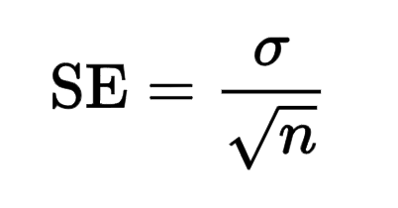
The Standard Error
SD tells us how well the mean represents the sample data
SE tells us how far the sample mean is likely to be from the true population mean – if you collected many samples, the average deviation of those sample means from the grand mean is the SE
Notes:
The standard deviation (SD) measures the amount of variability, or dispersion, from the individual data values to the mean, while the standard error of the mean (SEM) measures how far the sample mean (average) of the data is likely to be from the true population mean
The standard error is the SD over the square root of the sample. The SE gets smaller as your sample gets bigger.
This makes sense, because the mean of a large sample is likely to be closer to the true population mean than is the mean of a small sample. ... The SD does not change predictably as you acquire more data.

Slide 16
Hypothesis Testing
Null hypothesis, H0
There is no effect.
E.g. Big Brother contestants and members of the public will not differ in their scores on personality disorder questionnaires
The alternative hypothesis, H1
AKA the experimental hypothesis
E.g. Big Brother contestants will score higher on personality disorder questionnaires than members of the public

Slide 17
Test Statistics
A Statistic for which the frequency (distribution) of values is known (under the null hypothesis).
Observed values can be used to test hypotheses. We use the test statistic to calculate the probability of observing a particular test statistic value (or a more extreme value) if the null hypothesis is true
Notes:
A test statistic is a random variable that is calculated from sample data and used in a hypothesis test. You can use test statistics to determine whether to reject the null hypothesis. The test statistic compares your data with what is expected under the null hypothesis. The test statistic is used to calculate the p-value.

Slide 18
P-values
Which statement best captures the concept of a p-value?
The probability of the null hypothesis, given the observed test statistic
The probability of the observed test statistic, given the null hypothesis
Notes:
A test statistic is a random variable that is calculated from sample data and used in a hypothesis test. You can use test statistics to determine whether to reject the null hypothesis. The test statistic compares your data with what is expected under the null hypothesis. The test statistic is used to calculate the p-value.

Slide 19
P-values
Which statement best captures the concept of a p-value?
The probability of the null hypothesis
The probability of the data (assuming the null hypothesis)
Notes:
A test statistic is a random variable that is calculated from sample data and used in a hypothesis test. You can use test statistics to determine whether to reject the null hypothesis. The test statistic compares your data with what is expected under the null hypothesis. The test statistic is used to calculate the p-value.

Slide 20
Assumptions
Parametric tests based on the normal distribution assume:
Additivity and linearity
Normality (of what? – distribution of parameters, residuals)
Homogeneity of Variance
Independence

Slide 21
Additivity and Linearity
The outcome variable is linearly related to any predictors
If you have several predictors then their combined effect is best described by adding their effects together
If this assumption is not met then your model is invalid

Slide 22
Normally Distributed
The normal distribution is relevant to:
Parameters
Confidence intervals around a parameter
Null hypothesis significance testing

Slide 23
When does the assumption of normality matter?
In small samples
The central limit theorem allows us to forget about this assumption in larger samples
In practical terms, as long as your sample is fairly large (> N = 30), outliers (non-linearity & heterogeneity) are a much more pressing concern than normality
However, non-normal residuals may occur along with (they may indicate) violations of linearity and or homogeneity of variance …

Slide 24
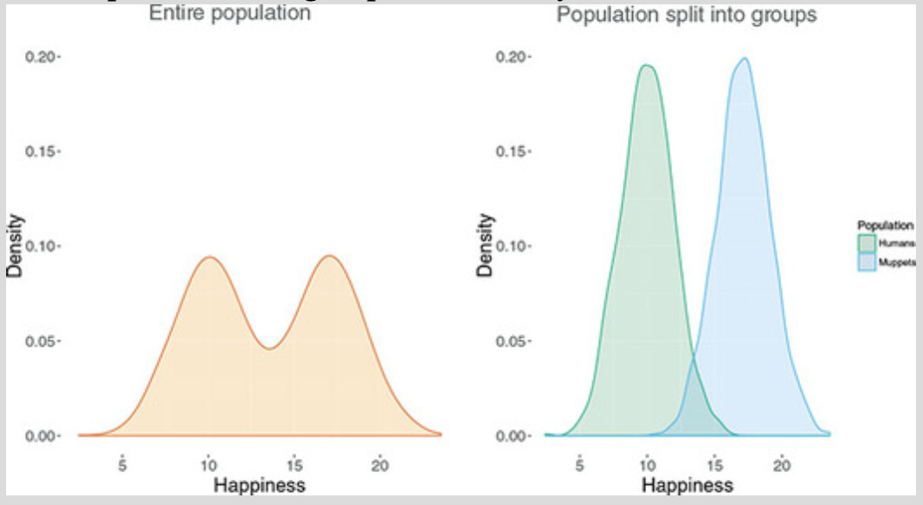
assumption of normality
Not about the data, about the residuals

Slide 25
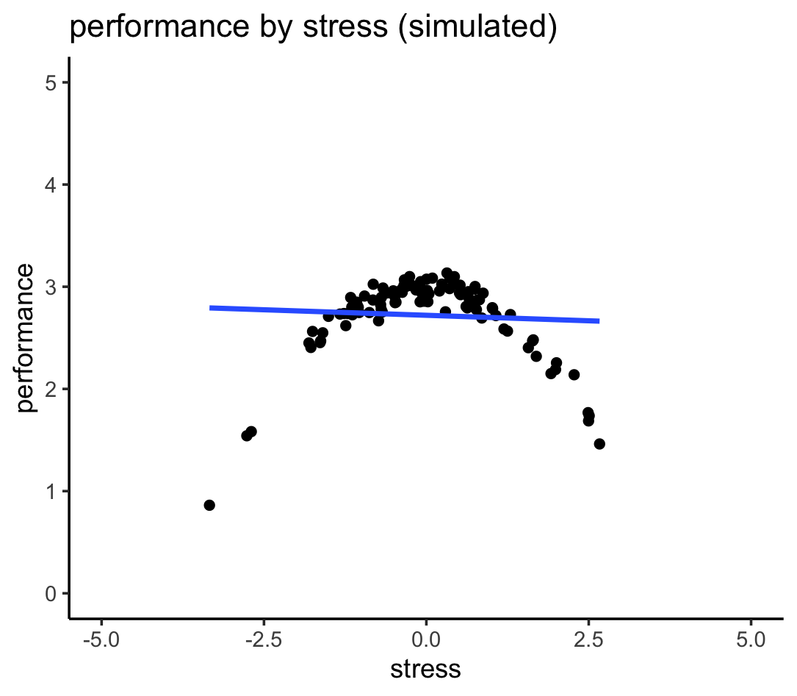
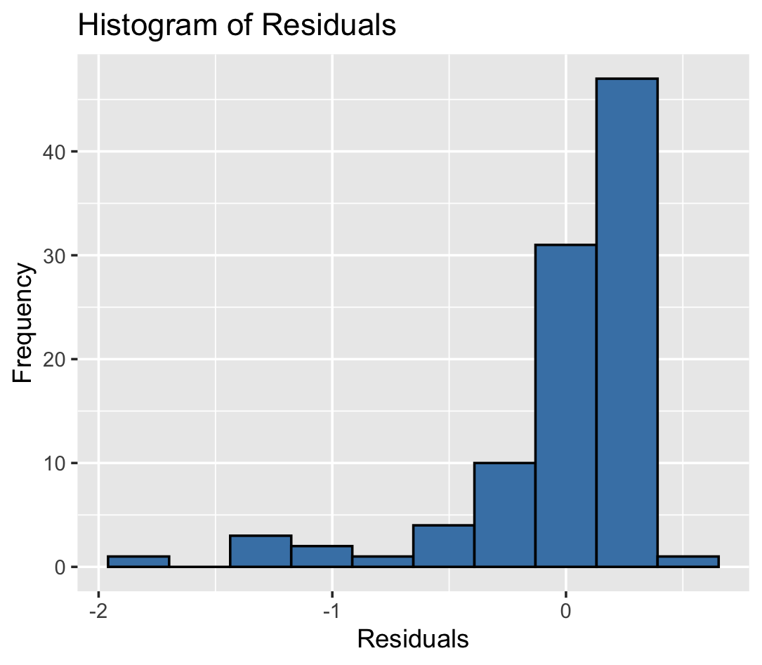
A well-known nonlinear association

Slide 26
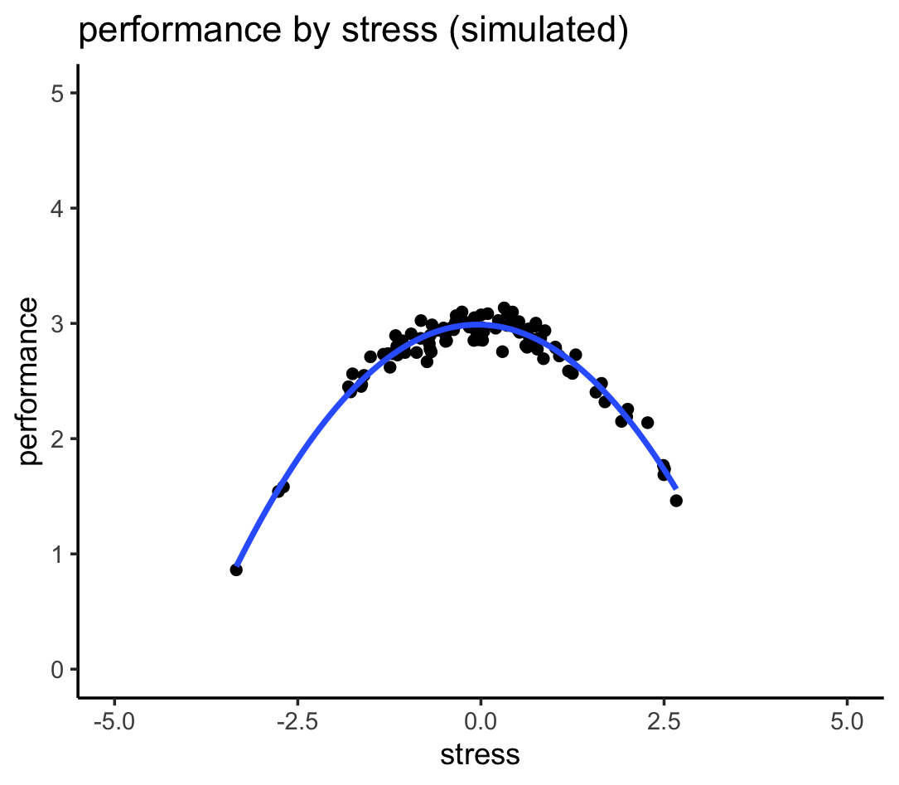
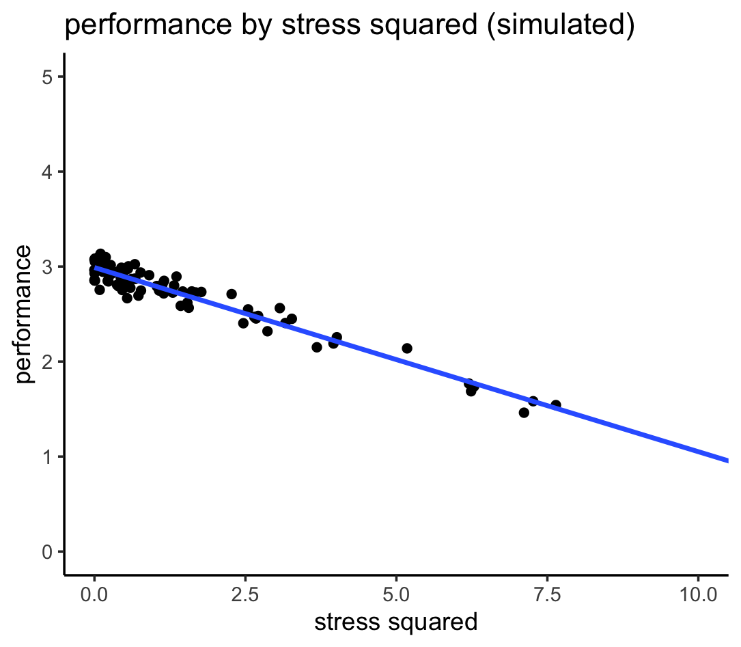
A well-known nonlinear association
OR

Slide 27
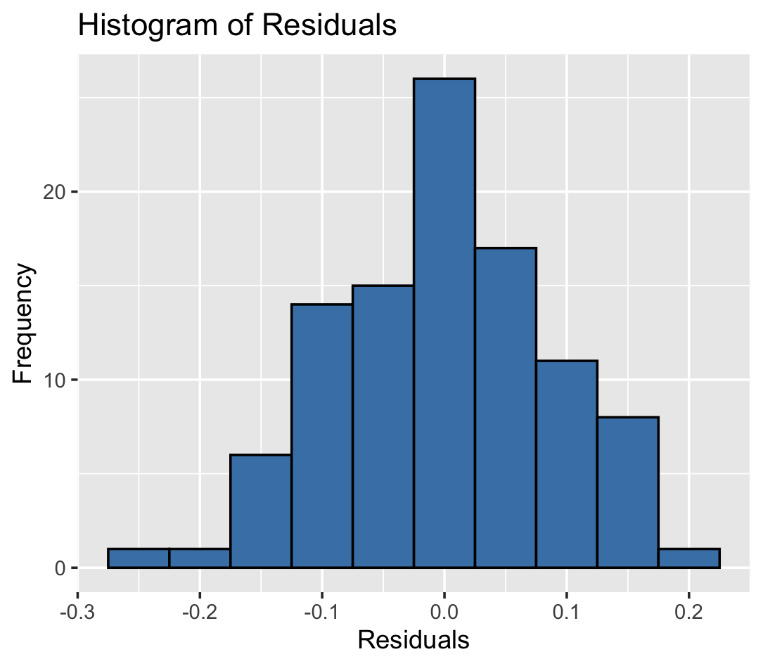
A well-known nonlinear association

Slide 28
Homoscedasticity/ Homogeneity of Variance
When testing several groups of participants, samples should come from populations with the same variance
In correlational designs, the variance of the outcome variable should be stable at all levels of the predictor variable

Slide 29
Homoscedasticity/ Homogeneity of Variance
Can affect the two main things that we might do when we fit models to data:
Parameters
Null Hypothesis significance testing

Slide 30
Homoscedasticity/ Homogeneity of Variance

Slide 31
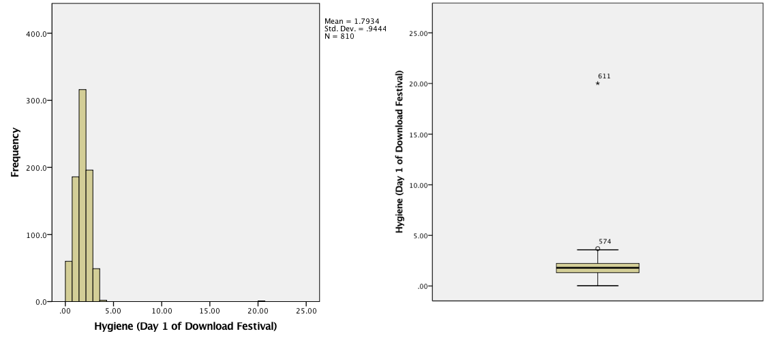
Spotting Outliers

Slide 32
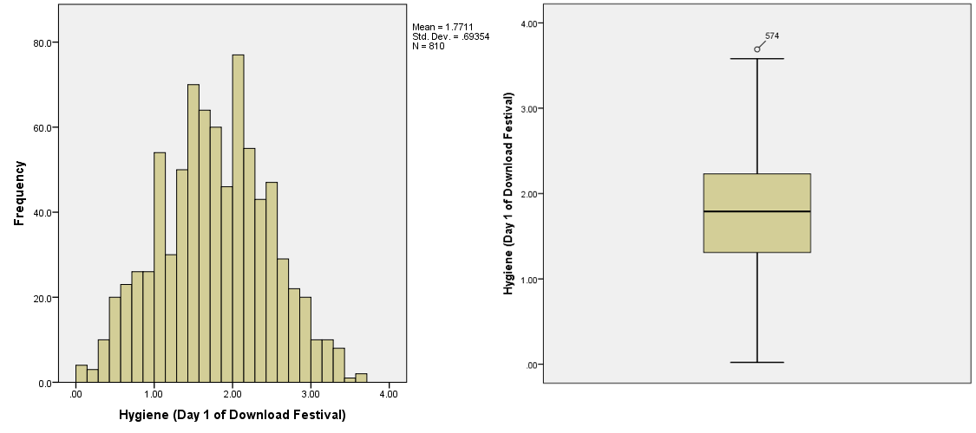
Spotting Outliers

Slide 33
Spotting Normality
Central Limit Theorem
If N > 30, the sampling distribution is normal anyway (arguably)
Graphical displays
P-P Plot (or Q-Q plot)
Histogram
Values of skew/kurtosis
0 in a normal distribution
Kolmogorov-Smirnov Test (but the result depends on N)

Slide 34
What happens when assumptions are violated?
Make an a-priori rule about identifying and eliminating outliers (e.g., +/- 3 SD from mean)
Why would it be okay to eliminate data?
Transform the data by applying a mathematical function to scores
Changes the interpretation of the association
Use Non-parametric tests (more on this later)
Changes the interpretation of the association

Slide 35
Transforming Data
Log transformation (log(x_{i}))
Reduce positive skew.
Square root transformation (√x_{i}):
Also reduces positive skew. Can also be useful for stabilizing variance.
Reciprocal transformation (1/ x_{i}):
Dividing 1 by each score also reduces the impact of large scores. This transformation reverses the scores, you can avoid this by reversing the scores before the transformation, 1/(x_{highest} – x_{i}).

Slide 36
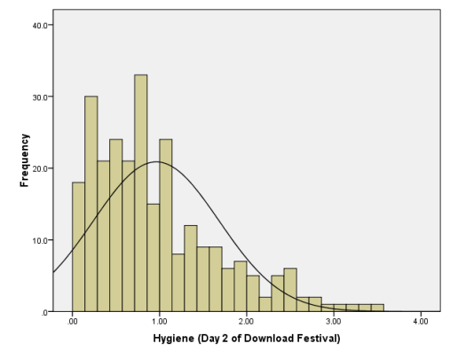
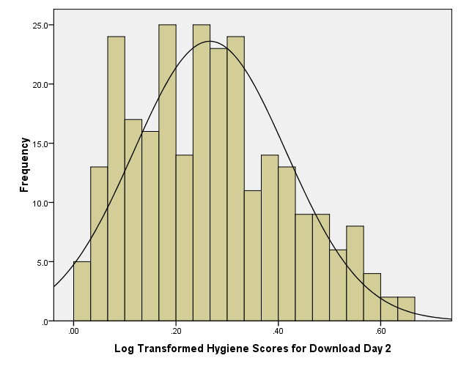
Log Transformation
Before
After

Slide 37
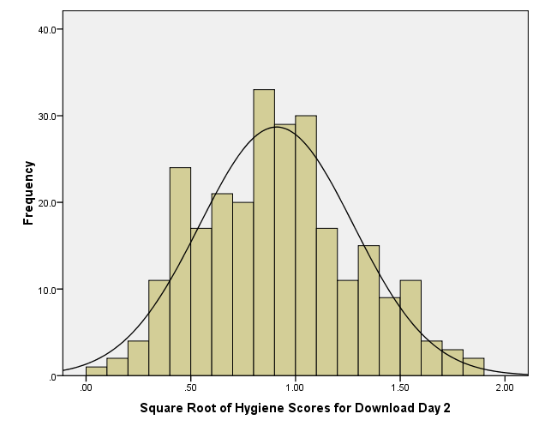
Square Root Transformation
Before
After

Slide 38
How do you decide?
Have a plan before you collect data
Plan should be based on:
Your hypotheses and what’s right for your dataset
What is typical or standard in your field
The proposed size of your sample
The robustness of your proposed effect
A systematic, thoughtful rationale

Slide 39
Summary

Slide 40
Data Visualization
You need to do it before you analyze your data (to check for all of the issues we just discussed!)
But also, to represent your data clearly and concisely to an audience

Slide 41
The Art of Presenting Data
Graphs should (Tufte, 2001):
Show the data
Induce the reader to think about the data being presented (rather than some other aspect of the graph)
Avoid distorting the data
Present many numbers with minimum ink
Make large data sets (assuming you have one) coherent
Encourage the reader to compare different pieces of data

Slide 42
WHAT’S
THIS
WRONG
GRAPH?
WITH

Slide 43
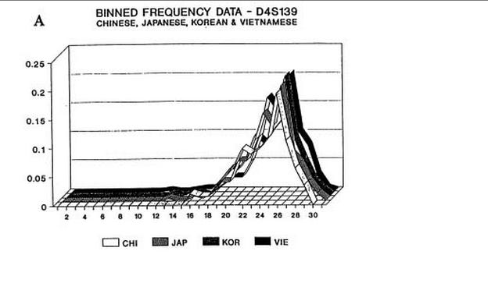
What’s wrong with this graph?
Notes:
Meaningless 3rd dimension!

Slide 44
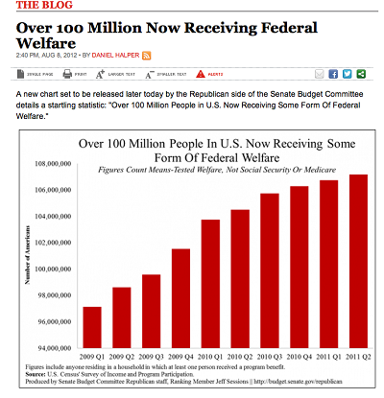
What’s wrong with this graph?
Notes:
SCALE!!
USA today is notorious for fussy graphs that have too much information and mislead. This graph makes our welfare problem look like it’s spiraling out of control. But note where the y-axis starts…at 94 million!
Fox News showed this chart of what would happen if the Bush tax cuts expired. Disastrous, right? Again, check the scale (it starts at 34). All is not what it seems.

Slide 45
What’s wrong with this graph?
Notes:
Fox News showed this chart of what would happen if the Bush tax cuts expired. Disastrous, right? Again, check the scale (it starts at 34). All is not what it seems.

Slide 46
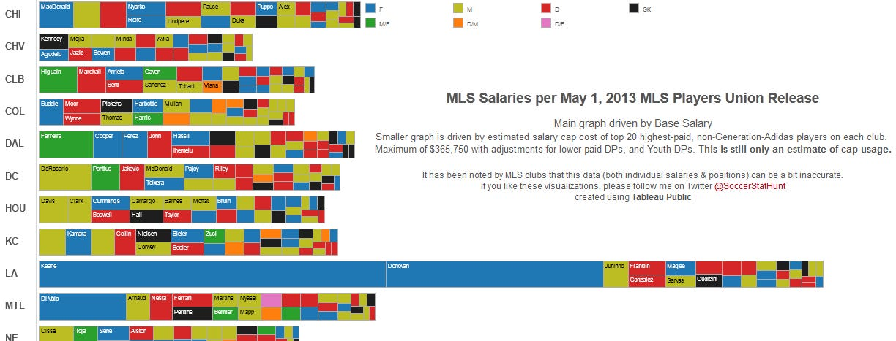
What’s wrong with this graph?
Notes:
I never thought it was possible but I actually understand soccer less after looking at this chart.

Slide 47
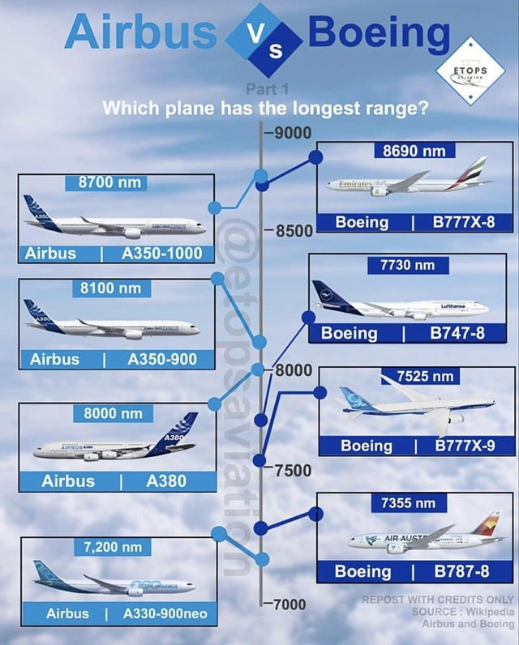
What’s wrong with this graph?

Slide 48

Watch out for accidental messages!

Slide 49
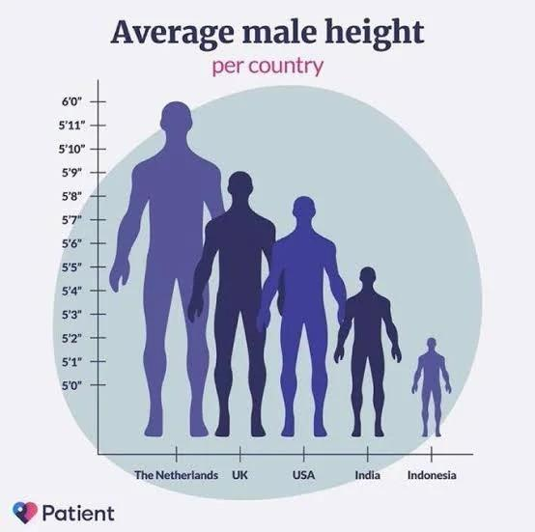
What’s wrong with this graph?

Slide 50
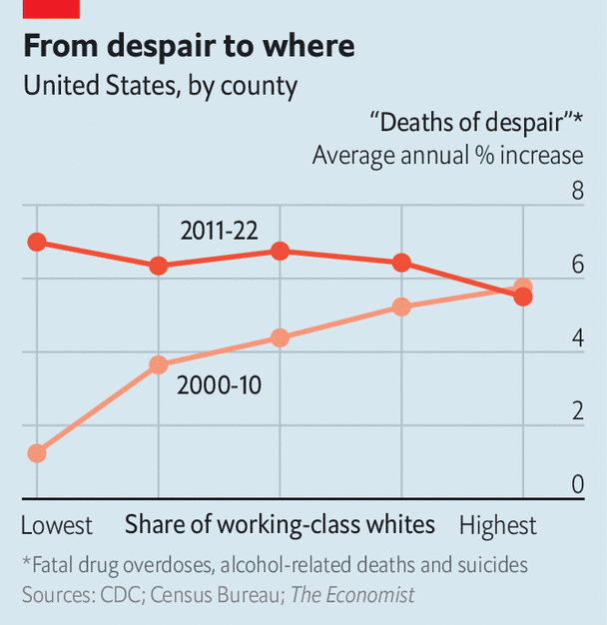
What’s wrong with this graph?

Slide 51
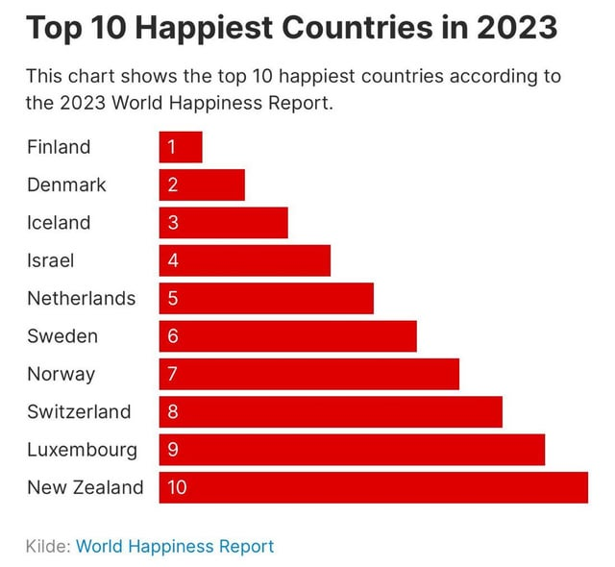
What’s wrong with this graph?

Slide 52

What’s wrong with this graph?

Slide 53
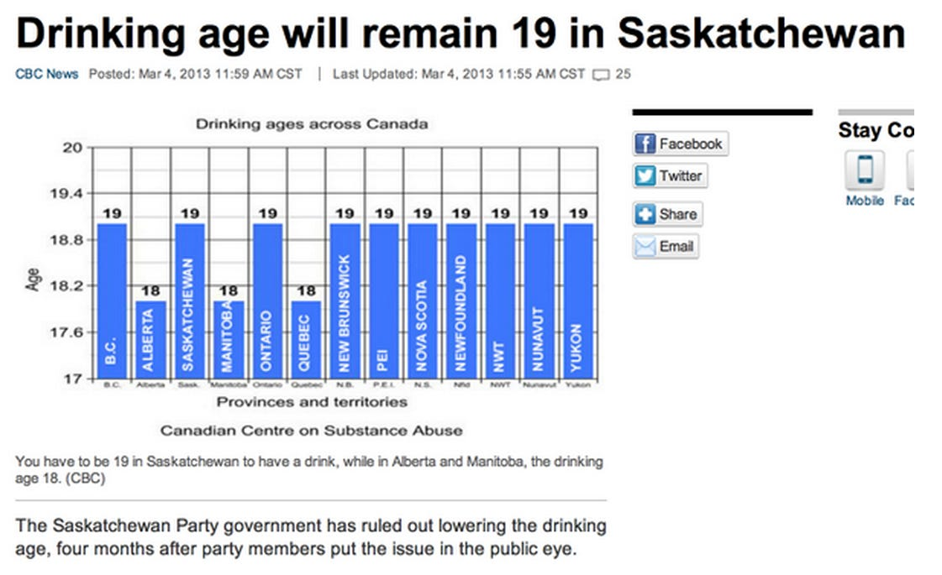
What’s wrong with this graph?
Notes:
You don’t need a graph for this. Only 3 provinces are different.

Slide 54
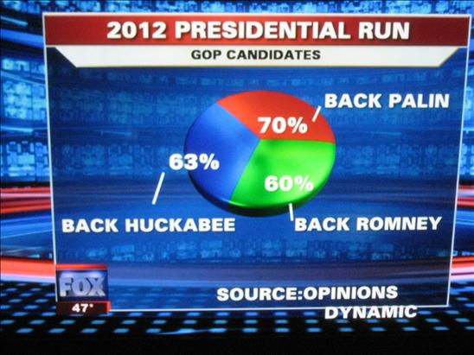
What’s wrong with this graph?
Notes:
Numbers don’t add up!

Slide 55

What’s wrong with this graph?
Notes:
No data labels! It tells us nothing!

Slide 56
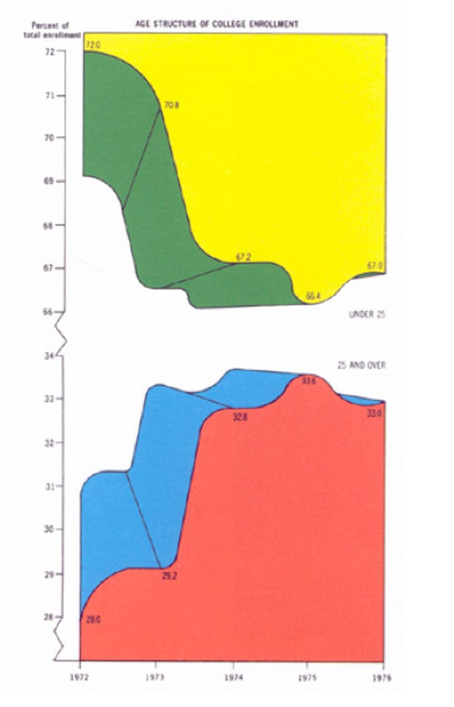
What’s wrong with this graph?
Notes:
So so much.
Edward Tufte — the guy who invented the word "chartjunk" — personally held this up as the worst chart ever. Why? The colors may induce ocular bleeding, it's in three dimensions for no reason, the Y-axis is broken twice, The chart only communicates five numbers — it's showing the breakdown of students under 25 and over 25 over 5 years — and the top section is inexplicably inverted.

Slide 57
Histograms
Histograms plot:
The score (x-axis)
The frequency (y-axis)
Histograms help us to identify:
The shape of the distribution
Skew
Kurtosis
Spread or variation in scores
Unusual scores

Slide 58
Boxplots (box-whisker diagrams)
Boxplots are made up of a box and two whiskers.
The box shows:
The median
The upper and lower quartile
The limits within which the middle 50% of scores lie.
The whiskers show
The range of scores
The limits within which the top and bottom 25% of scores lie

Slide 59
Boxplots

Slide 60
Spotting Outliers

Slide 61
Spotting Outliers

Slide 62
Error Bars in Charts
The bar (usually) shows the mean score
The error bar sticks out from the bar like a whisker.
The error bar displays the precision of the mean in one of three ways:
The confidence interval (usually 95%)
The standard deviation
The standard error of the mean

Slide 63
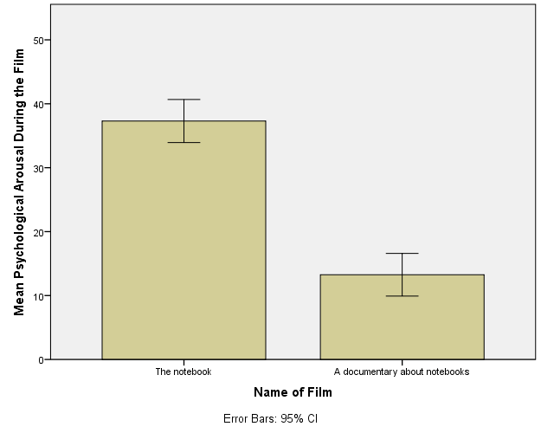
Bar Graph: One Independent Variable

Slide 64
Bar Graphs
Tells us about the relationship between two groups of variables (can be continuous or discontinuous)
Oftentimes different bars refer to different groups of people, but can also used for within-subjects designs

Slide 65
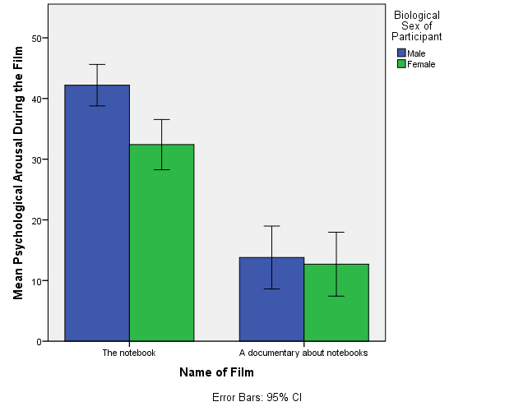
Bar Graph: Two Independent Variables

Slide 66
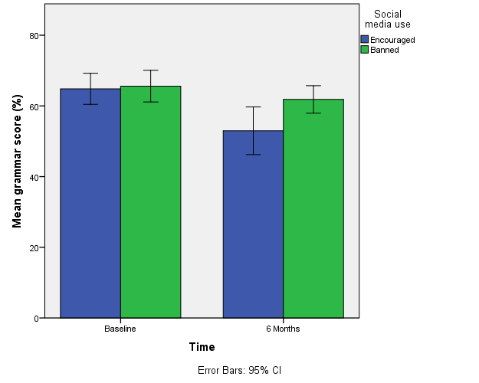
Bar Graph: Mixed Designs

Slide 67
Line Graphs
Tells us about the relationship between two variables (can be continuous or discontinuous)
The lines might be used to convey a connection between points (e.g., the same subjects in each condition), so this approach can be more effective for a within-subject design

Slide 68
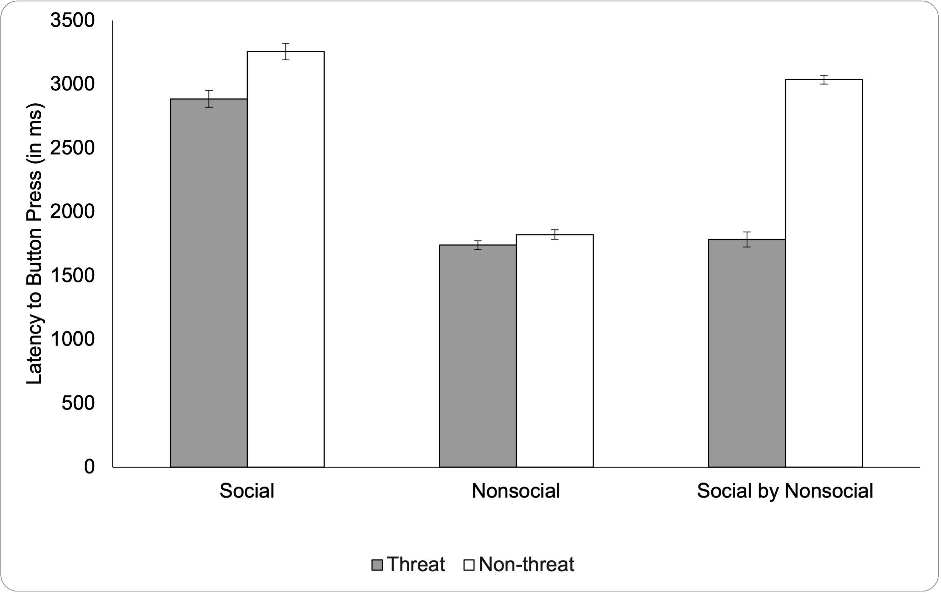
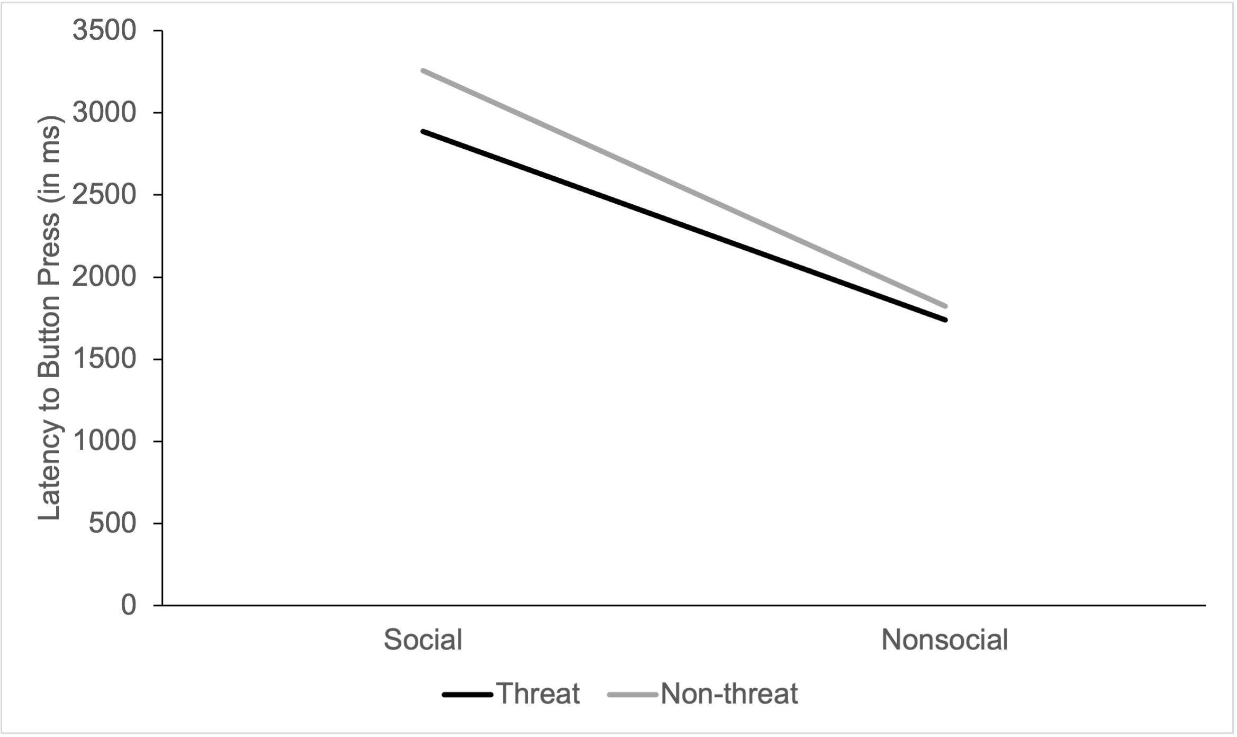
Line Graphs
Notes:
From my own data

Slide 69
Scatterplots
Tells us about the relationship between two continuous variables

Slide 70
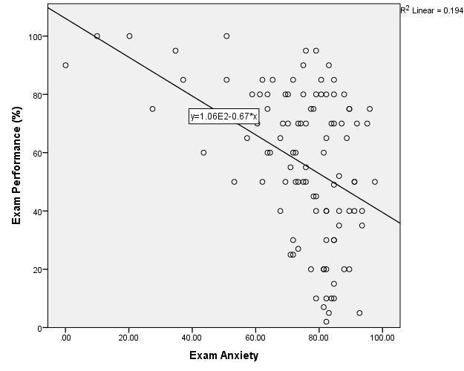
Simple Scatterplot

Slide 71
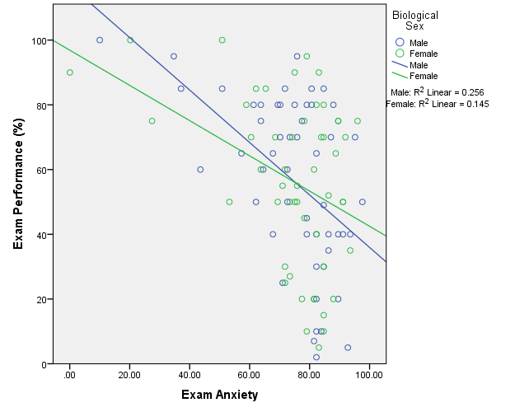
Grouped Scatterplot

Slide 72
Matrix Scatterplot

Slide 73
Some Basic Guidelines
Know your audience
Identify your message

Slide 74
Some Basic Guidelines
Know your audience
Identify your message
Adapt the figure to the support medium
Do not trust defaults

Slide 75
Some Basic Guidelines
Know your audience
Identify your message
Adapt the figure to the support medium
Do not trust defaults
Use color effectively

Slide 76
Use Color Effectively

Slide 77
Some Basic Guidelines
Know your audience
Identify your message
Adapt the figure to the support medium
Do not trust defaults
Use color effectively
Captions are not optional
Do not mislead the reader

Slide 78
Do not mislead the reader
Notes:
Scale should have the max that you can measure.

Slide 79
Captions (and labels) are not optional!
Notes:
No data labels! It tells us nothing!

Slide 80
Some Basic Guidelines
Know your audience
Identify your message
Adapt the figure to the support medium
Do not trust defaults
Use color effectively
Captions are not optional
Do not mislead the reader
Avoid “chartjunk”

Slide 81
Avoid chart junk!
Notes:
Example from the book

Slide 82
Avoid chart junk!

Slide 83
Message trumps beauty

Slide 84
Message trumps beauty

Slide 85
Some Basic Guidelines
Know your audience
Identify your message
Adapt the figure to the support medium
Do not trust defaults
Use color effectively
Captions are not optional
Do not mislead the reader
Avoid “chartjunk”
Message trumps beauty
Get the right tool

